Slide 1
DSA:Unit 1
Prepared by
Gobinda subedi
For BIT, KIST

Slide 2
Prerequisite
Knowledge of C
From the point of exam, students should be familiar with algorithm and functions fluently.

Slide 3
Contents Of Unit 1
Information and its meaning of Date Structure
Abstract Data Type
ADT VS DS
Array in C
The array as an ADT
One dimensional array
Two dimensional array
Multidimensional array

Slide 4
Introduction
What is data structure?
A data structure is an arrangement of data in a computer’s memory (or sometimes on a disk) so that it can be used efficiently. Data structures include arrays, linked lists, stacks, binary trees, and hash tables, among others.
What is an Algorithm?
Algorithms manipulate the data in these structures in various ways, such as searching for a particular data item and sorting the data.

Slide 5
Introduction contd..
Data structures are the building blocks of a program.
Data structure mainly specifies the following four things:
Organization of data.
Accessing methods
Degree of associativity
Processing alternatives for information
To develop a program from an algorithm, we should select an appropriate data structure for that algorithm. Therefore algorithm and its associated data structures form a program.
Hence, we can say that
Algorithm + Data structure = Program

Slide 6
Introduction contd..
Data structure can be thought of in two basic ways:
A static data structure is one whose capacity is fixed at creation. For example, array.
A dynamic data structure is one whose capacity is variable, so it can expand or contract at any time. For example, linked list, binary tree etc.

Slide 7
Data Structure type
Data structure can be divided into two types:
Linear Data Structure: When the data is stored in the memory in the memory in linear or sequential form is called linear data structure. Examples include Array, Stack, Queue etc.
Non linear Data Structure: When the data is stored in the memory in disperse or non-sequential order is called non linear data structure. Example includes trees, graphs files etc.

Slide 8
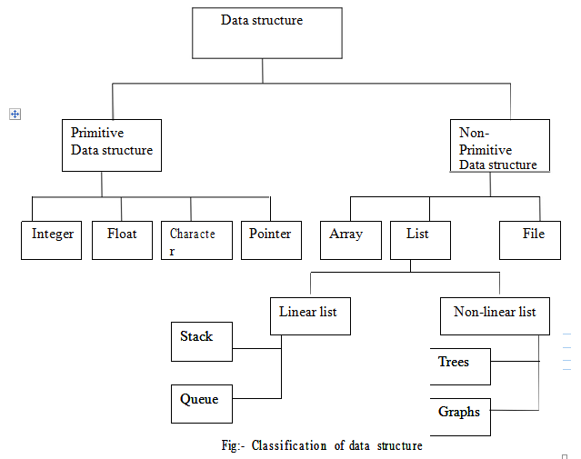
Classification of Data Structure

Slide 9
Data Operation Operations
Operations are used to process the data appearing in the data structure. Following are the some of the operations used frequently:
Traversing: Accessing each record exactly once so that certain items in the record may be processed.
Searching: Finding the location of the record with the given key value.
Inserting: Adding a new record
Deleting : Removing a record.
Sorting: Arranging the records in some logical order.
Merging: Combining the records in two different file into a single file.

Slide 10
Abstract Data Type (ADT)
Abstract data type (ADT) is a specification of a set of data and the set of operations that can be performed on the data. A set of data values and associated operations that are precisely specified independent of any particular implementation.
Real life example: Book is Abstract (Telephone Book is an implementation)

Slide 11
ADT vs DS
ADT is a logical description and data structure is concrete. ADT is the logical picture of the data and the operations to manipulate the component elements of the data. Data structure is the actual representation of the data during the implementation and the algorithms to manipulate the data elements. ADT is in the logical level and data structure is in the implementation level.
ADT is implementation independent. For example, it only describes what a data type List consists (data) and what are the operations it can perform, but it has no information about how the List is actually implemented.
Whereas data structure is implementation dependent, as in the same example, it is about how the List implemented i.e., using array or linked list. Ultimately, data structure is how we implement the data in an abstract data type.

Slide 12
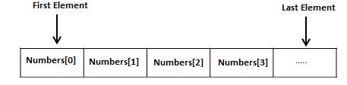
Overview of Array
Arrays a kind of data structure that can store a fixed-size sequential collection of elements of the same type. An array is used to store a collection of data, but it is often more useful to think of an array as a collection of variables of the same type.
All arrays consist of contiguous memory locations. The lowest address corresponds to the first element and the highest address to the last element.

Slide 13
Types of Array
One dimensional array:
The elements of the array can be represented either as a single column or as a single row.
Declaring one-dimensional array:
data_type array_name[size];
Following are some valid array declarations:
float weight[50];
int marks[100];
int age[15];
Array Initialization (1-D):
The general format of array initialization is:
data_type array_name[size]={element1,element2,…………..,element n};

Slide 14
#include <stdio.h>
int main ()
{
int n[ 10 ]; /* n is an array of 10 integers */
int i,j; /* initialize elements of array n to 0 */
for ( i = 0; i < 10; i++ )
{
n[ i ] = i + 100; /* set element at location i to i + 100 */
}
/* output each array element's value */
for (j = 0; j < 10; j++ )
{
printf("Element[%d] = %d\n", j, n[j] );
}
return 0;
}

